Slide 1


FocuST Performance Commercial Company
Joel Mondal
IT 213 DL1
I did not include voice narration for two bonus points.
Site purpose: This commercial company sells parts to modify Focus St owners to their hearts desire; achieving real performance.

Slide 2
Home page (page 1 – index.html) - desktop
Home Page URL: mason.gmu.edu/~jmondal2/IT213Webpage/index.html
Page purpose: To give the customer a visual clue as to what our company is and the the products we offer
Key features of page (listed with bullet points)
Animated gif with message displayed (project 4)
How are they implemented (if relevant)
The file is displayed in the middle of the page
Screenshot of home page (desktop view)

Slide 3
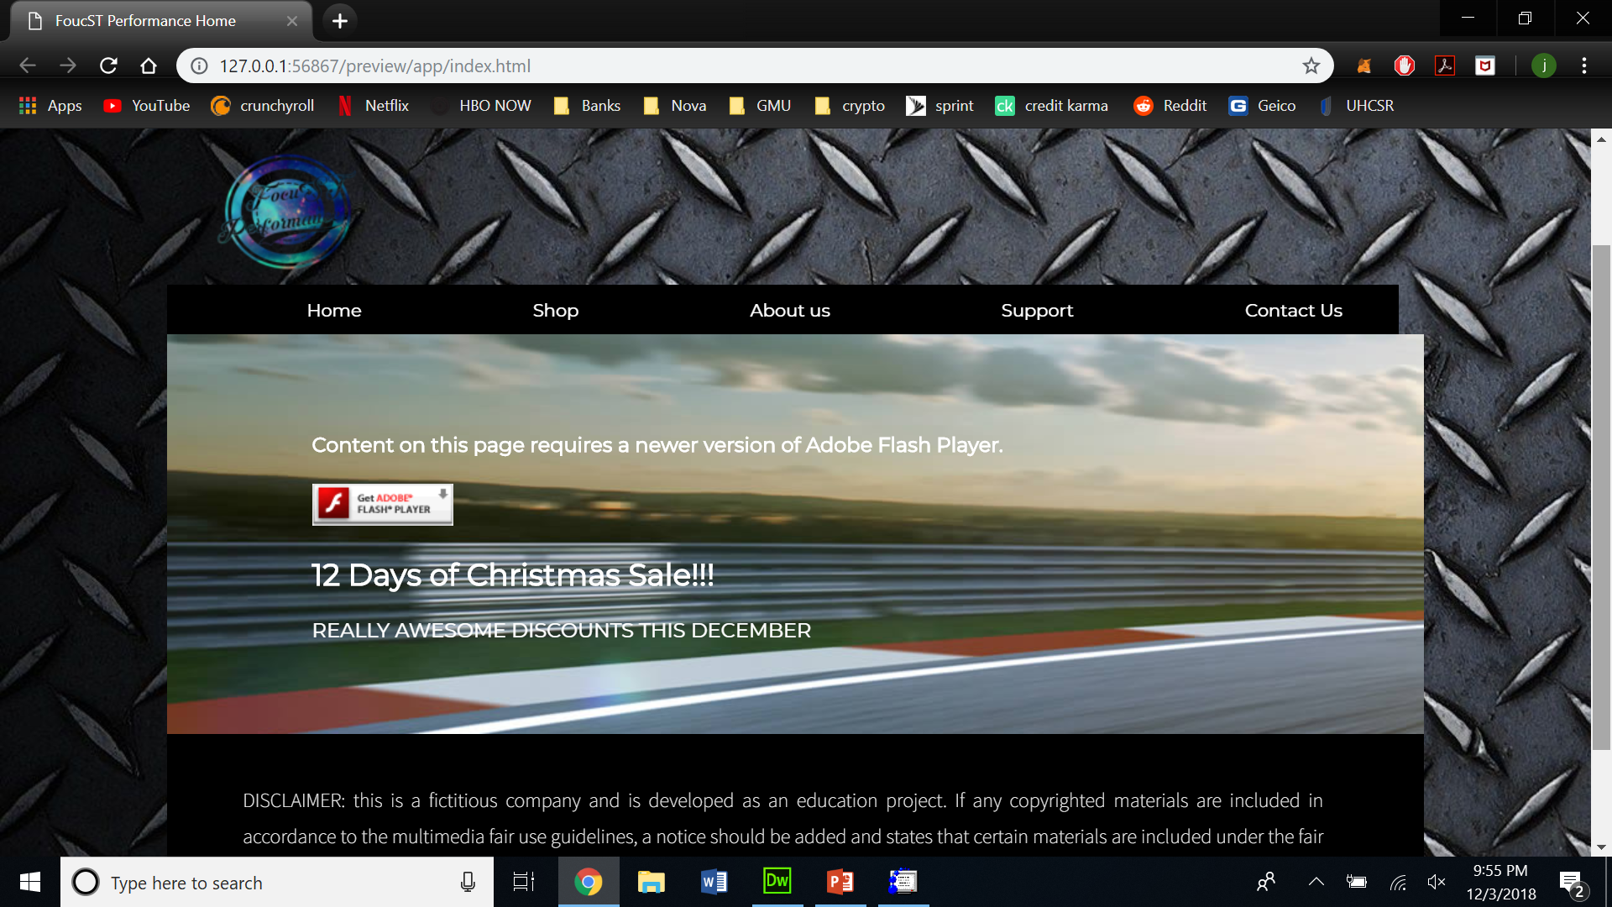

Slide 4
Home page (page 1 – index.html) - tablet
Key features of page (listed with bullet points)
Animated gif with message displayed (project 4)
How are they implemented (if relevant)
The file is displayed in the middle of the page
Screenshot of home page (tablet view)

Slide 5
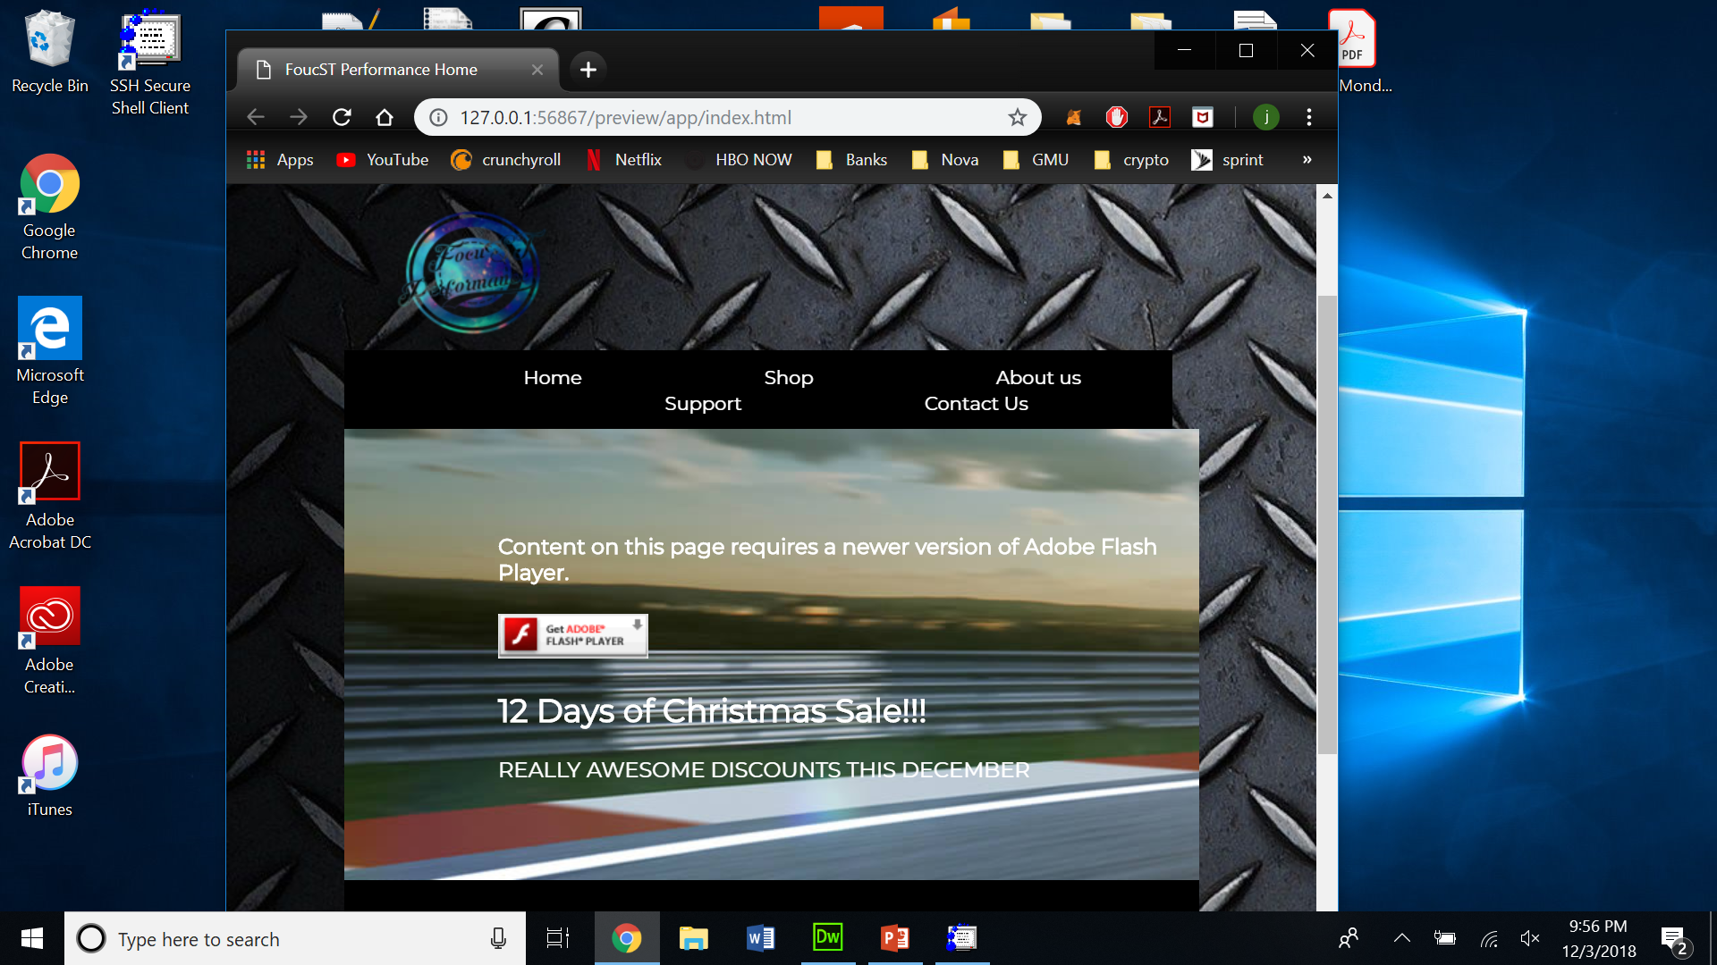

Slide 6
Home page (page 1 – index.html) - mobile
Key features of page (listed with bullet points)
Animated gif with message displayed (project 4)
How are they implemented (if relevant)
The file is displayed in the middle of the page
Screenshot of home page (mobile view)
I screen shotted the webpage on my iphone; I wasn’t sure as to how you wanted us to present that

Slide 7
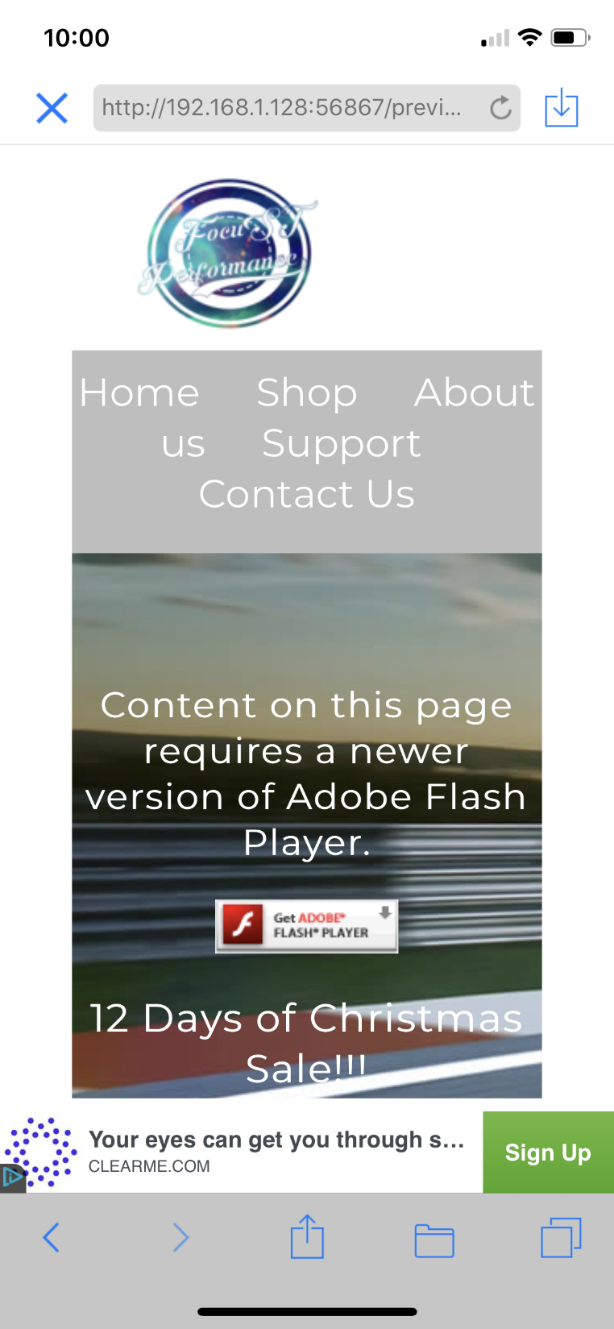

Slide 8
Second completed page
Page URL: mason.gmu.edu/~jmondal2/IT213Webpage/shop.html
Page purpose: Displays items available for sale
Key features of page (bullet points)
Categorical menu with search bar to the left
Screenshot of page

Slide 9
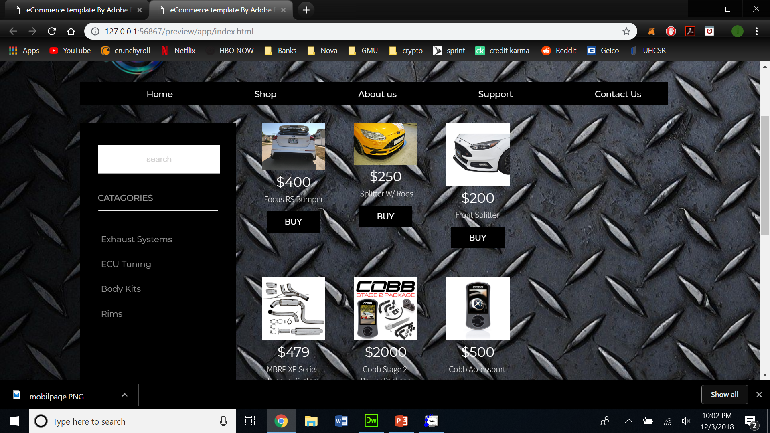

Slide 10
Third completed page
Page URL:
mason.gmu.edu/~jmondal2/IT213Webpage/aboutus.html
Page purpose: Explains company objective
Key features of page (bullet points)
Simple message with graphical background
Screenshot of page

Slide 11
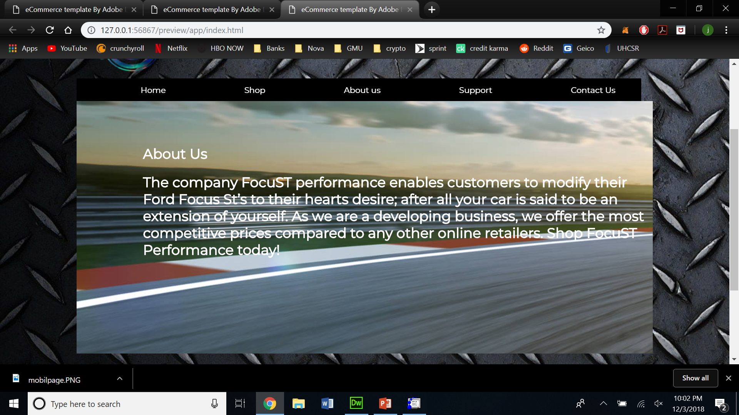

Slide 12
Fourth completed page
Page URL: mason.gmu.edu/~jmondal2/IT213Webpage/support.html
Page purpose: Informational page with links with links to:
Official ford website
Power stages
How to forum for installation
Key features of page (bullet points)
Images with links embedded
Screenshot of page

Slide 13
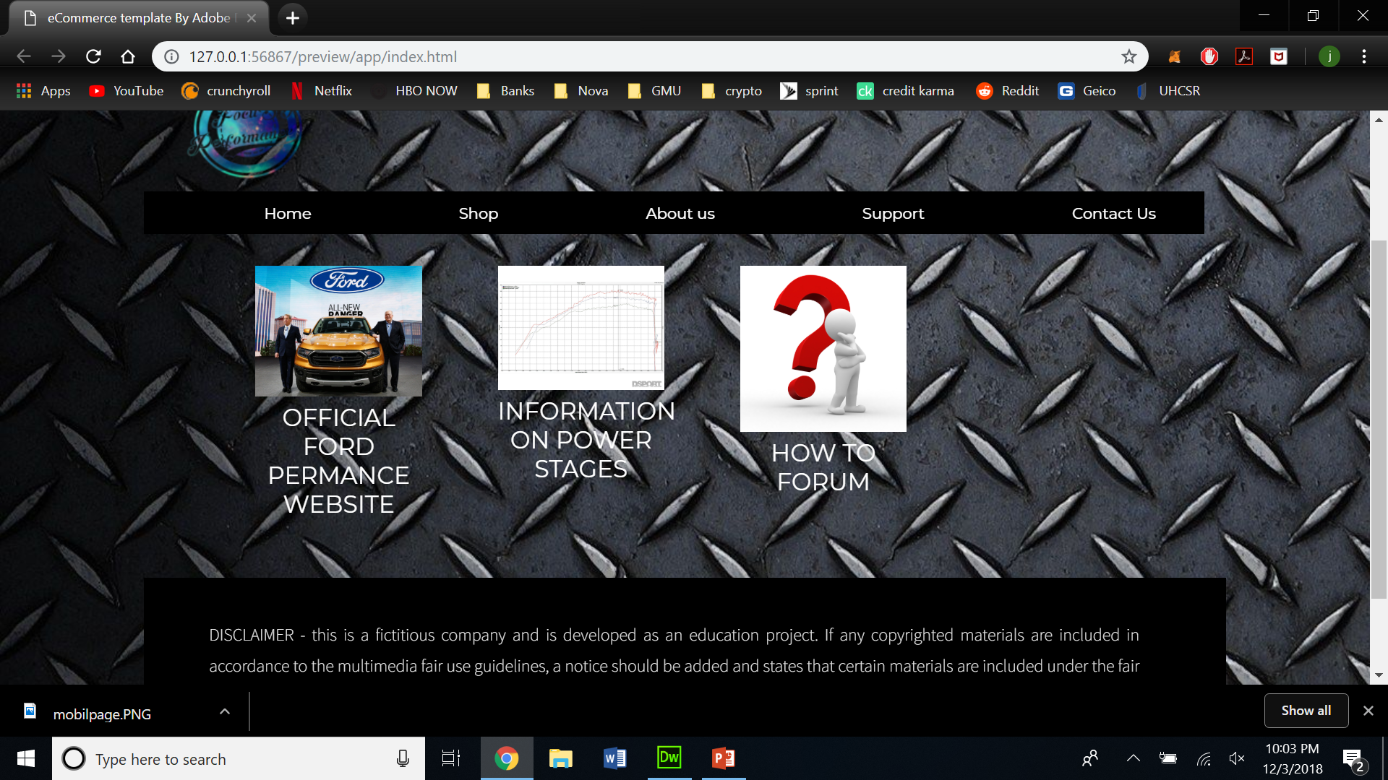

Slide 14
Fifth completed page
Page URL: mason.gmu.edu/~jmondal2/IT213Webpage/contactus.html
Page purpose: Displays company phone number and email (both of which are fake)
Key features of page (bullet points)
Google maps with company location (fake location)
How are they implemented (if relevant)
Google provided html to location
Screenshot of page

Slide 15
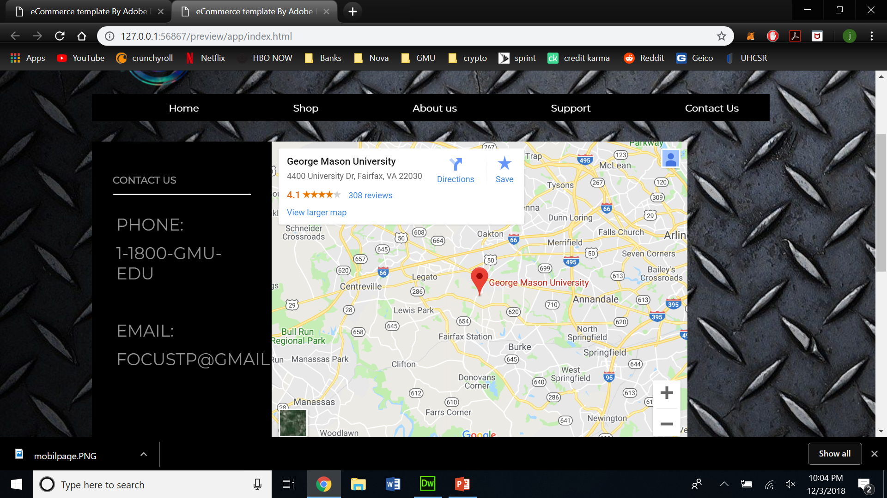

Slide 16

Requirement: Logo
Company name with a galaxy background
Metaphor for infinite modification possibilities

Slide 17
Requirement: Navigation bar/menu/tab with rollover buttons/links
Bottom will react with change of gradient color while cursor is hovering over the link
Screenshot examples of Functionality/Implementation
I'm am still working on this part, I have yet to implement it into my pages but I will by the final submission

Slide 18
Requirement: Flash commercial
Purpose of/ Description of/ Functionality of/ Implementation of Flash commercial (bullet points):
The animation gives the customers a hint as to what products our company sells which is why it is displayed on the home page.
Screenshot of opening Flash commercial:

Slide 19
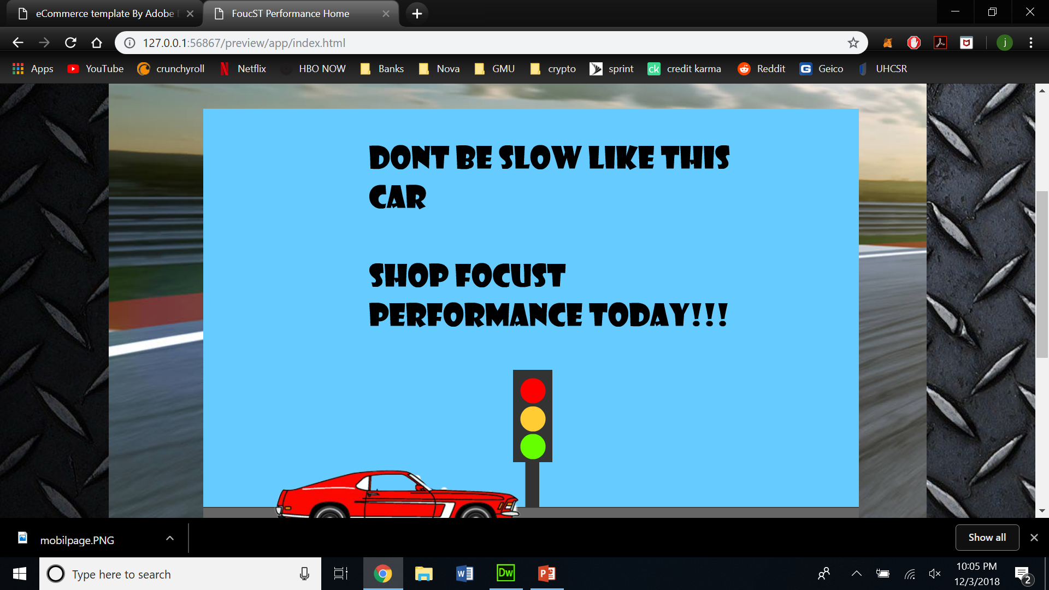

Slide 20
Requirement: Favicon
Purpose of/ Description of: My favicon is a picture of a Focus St that has been converted to a png.
Screenshot of Favicon on home page:
I cant seem to get this to work but I have attached the image I will be using

Slide 21


Slide 22
Requirement: Skip links
Purpose of Skip Links: Typically used to aid navigation for screen reader users
Screenshot of VISIBLE skip links on your five pages:
The links are displayed at the top left hand corners of all my webpages

Slide 23
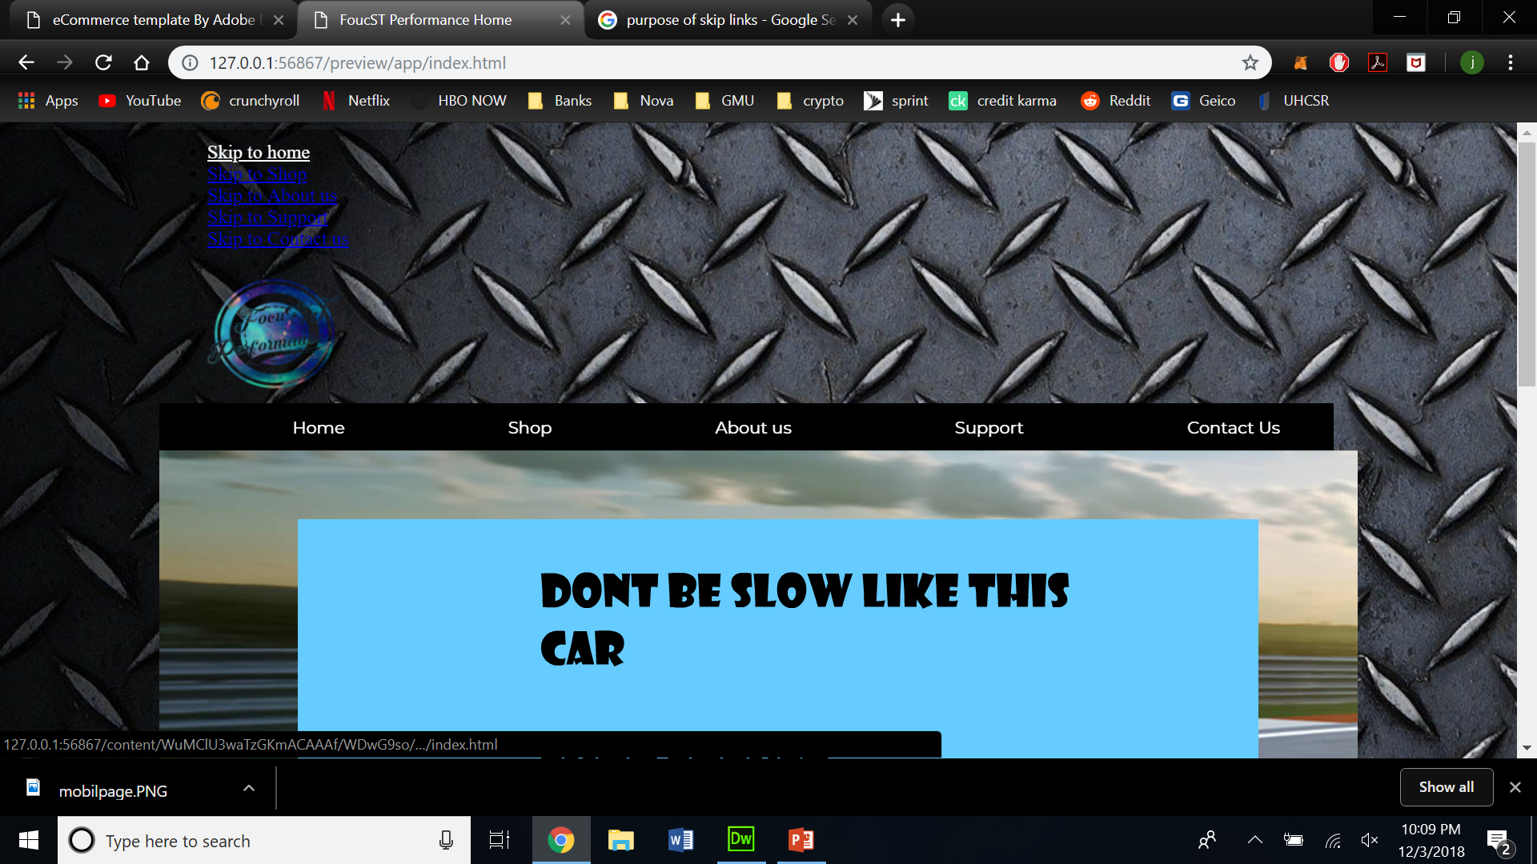

Slide 24
Reasons for use and implementation of google maps on our webpages
Google provides html code if you want to load this maps onto your site which is pretty useful
Neat widget that zooms in and out of tagged location
Gives customers the option to visit company store in person
Proves legitimacy of the company

